Slide 1
Classification on Chocolate Bar
Wong Ho Sum, 12311942

Slide 2
Why is this topic
Interested in Classification
Food dataset -> Good classification dataset
Chocolate bar is one of the popular snack in the world

Slide 3
Dataset

Slide 4
Dataset
This dataset is collected by Brady Brelinski, Founding Member of the Manhattan Chocolate Society.
http://flavorsofcacao.com/

Slide 5
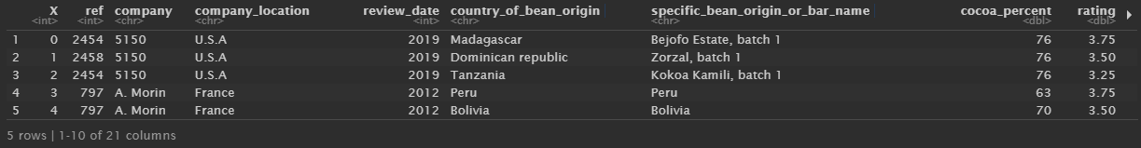
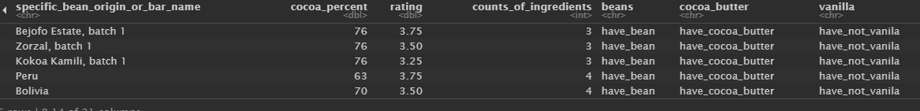
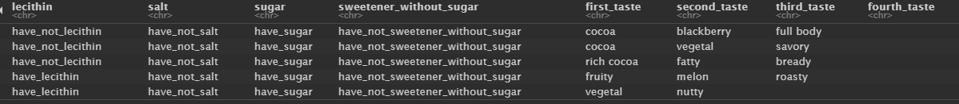
Variables in dataset

Slide 6
Variables We Need
Cocoa_percent
Rating
Counts_of_ingredients
Cocoa_butter
Vanilla
Lecithin
Salt
Sugar
Sweetener_without_sugar

Slide 7
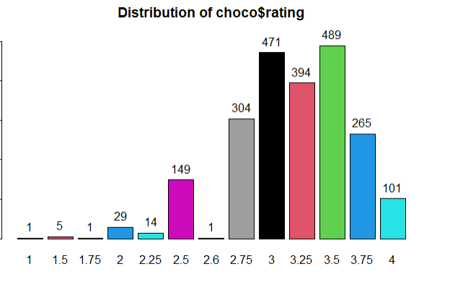
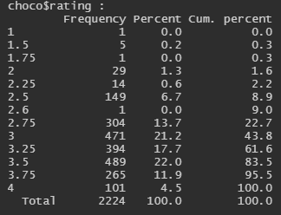
Variables in dataset
Rating is a score out of 5 for chocolate bar
Dependent variable Y
Most of rating(2.5-4)

Slide 8
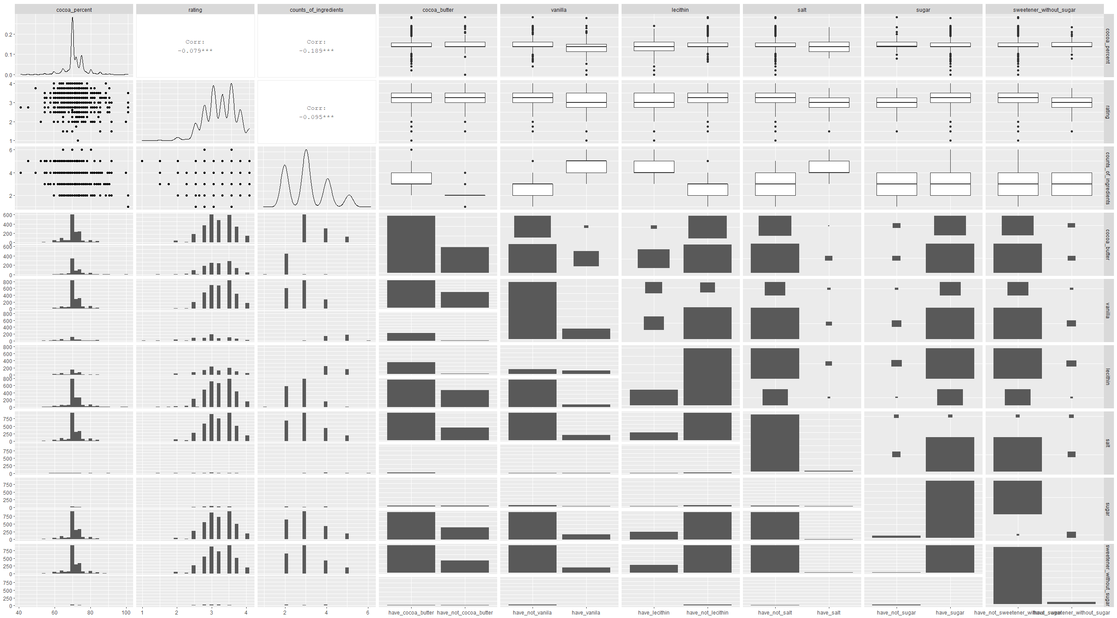
Variables in dataset

Slide 9
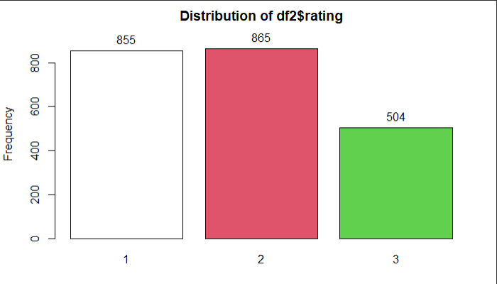
Class -> Rating
Class 1 -> more than or equal to 3.5
Class 2 -> between 3.5 and3
Class 3 -> below 3

Slide 10
Sample Size
We will be using 80% training and 20% testing in this project
Pareto principle
The Pareto Principle, named after esteemed economist Vilfredo Pareto, specifies that 80% of consequences come from 20% of the causes, asserting an unequal relationship between inputs and outputs. (Vilfredo Pareto)

Slide 11
Support Vector Machines

Slide 12
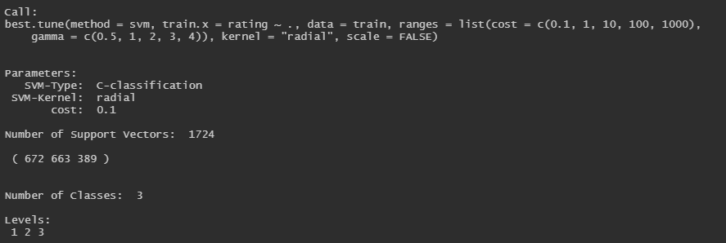
SVM
Using tune() to find out best SVM

Slide 13

Accuracy of SVM with 3 Class(8:2)
(69+107)/(69+107+84+70+30+85)=40%
We have only 40% accuracy.

Slide 14

SVM with 3 Class (5:5)
(289+129+18)/1112
We have only 39% accuracy

Slide 15
Model with 2 label

Slide 16
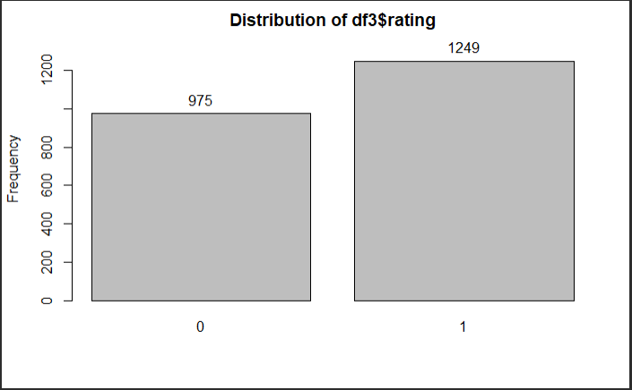
Class -> Rating
Class 0 -> below 3.25
Class 1 -> Higher than or equal to 3.25

Slide 17
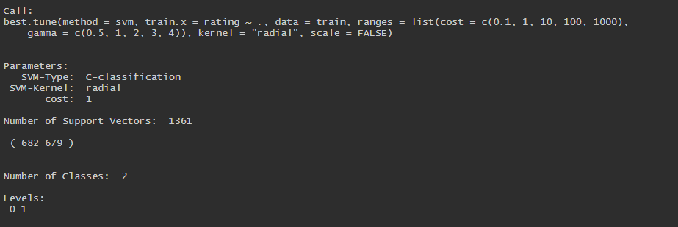
SVM with 2 Class (8:2)
We using tune() again to perform SVM regression

Slide 18

SVM (8:2)
(88+191)/(88+191+118+48)=0.6269
This SVM model with 2 class have 63% accuracy

Slide 19
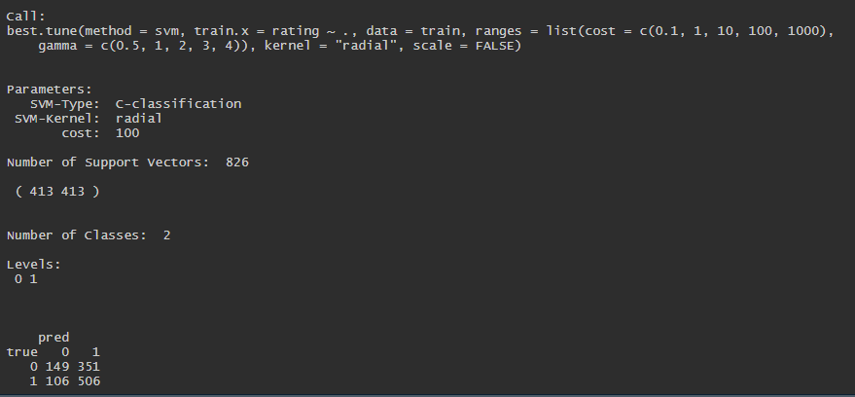
SVM (5:5)
(149+506)/(149+506+106+351)=0.5890
This SVM model with 2 class have 59% accuracy

Slide 20
SVM performance not bad, the accuracy is acceptable (62 %)
But can be better!!!

Slide 21
Logistics Regression

Slide 22
Logistics Regression
We need a dependent variable in binary
Class 0 -> Not good
Class 1 -> Good

Slide 23
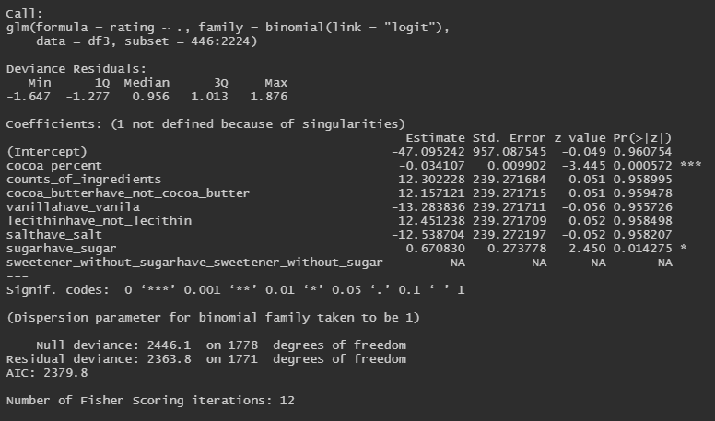
Logistics Regression

Slide 24
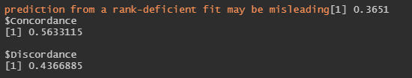
Logistics Regression
The fitted Logistics Regression
Concordance = 0.5633 -> 1 is perfect model
The accuracy of this model is 63%

Slide 25
Decision Tree and Random Forest

Slide 26
Decision Tree or Random Forest?
Decision tree model
If training data set Large, accuracy will increase.
Easy to interpret
Easily overfit the data
Random Forest model
Specify the number of features in each tree
Must be randomness
If more tree in the model, accuracy will increase

Slide 27
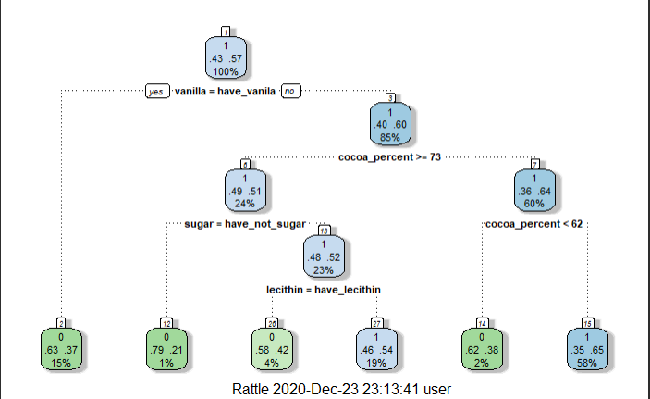
Decision Tree

Slide 28

Decision Tree
The accuracy of decision tree
(65+196)/(65+196+141+43)=0.59
Nearly 60%, not bad!!

Slide 29

Decision Tree 5:5
The accuracy of decision tree
(171+494)/(171+329+118+494)=0.5980
Nearly 60%, not bad!!

Slide 30
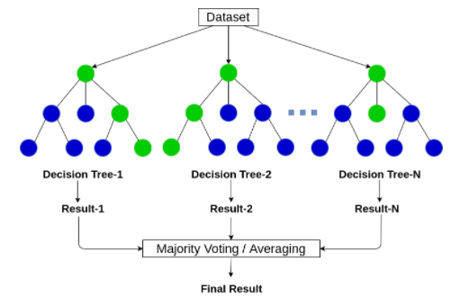
Random Forest

Slide 31
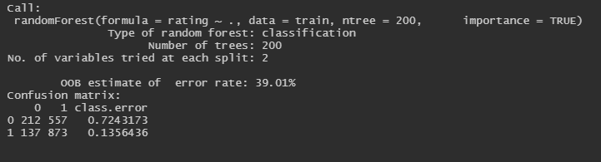
Random Forest
OOB estimate of error rate: 39.01%
Accuracy -> ~60%

Slide 32
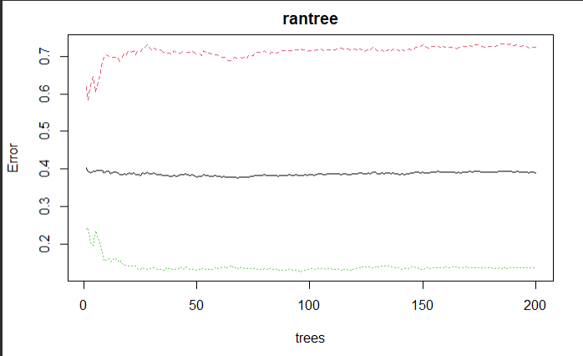

Slide 33
Red---Alzheimer
Black---OOB
Green---Control

Slide 34
Random Forest
In the result we should focus on class error
Which class 0 get 0.724

Slide 35

Class Error problem
SVM with 3 label
SVM with 2 label
Logistics Regression
Decision Tree
Random Forest

Slide 36
 | SVM with 3 label | SVM with 2 label | Logistics Regression | Decision Tree | Random Forest
Total Accuracy | 40% | 63% | 63% | 59% | 61%
Class 0 Accuracy |  | 42% | 57% | 32% | 28%
Class 1 Accuracy |  | 80% | 65% | 82% | 86%

Slide 37
Conclusion
SVM with 2 labels and Logistics Regression have better performance
After we solved the problem of distribution in this dataset

Slide 38
Limitation
Dataset does not large enough -> Some of the variable got weird distribution
Most of the data tend to one event
Country of beans origin is an important factor
But there are so many country with few observation
So it is hard to perform a regression
Company is facing same problem
Which is some of the company only have few observations

Slide 39
References
https://online.stat.psu.edu/stat857/node/220/
Eberly College of Science
https://www.investopedia.com/terms/p/paretoprinciple.asp
Investopedia
https://www.kaggle.com/soroushghaderi/chocolate-bar-2020
Kaggle

